Slide 1
Machine Learning
Mohamed Emam
Omar Emam
Yassin Fawzy
Sandra George

Slide 2
Project Goal
Detect fraudulent healthcare providers
  Use ML classification based on claims data
  Target variable: PotentialFraud

Slide 3
Dataset Overview
Training data contains provider information
  Claims, beneficiary details, and payment features
  Highly imbalanced target

Slide 4
Exploratory Analysis
Checked target distribution
  Identified missing values
  Examined numerical & categorical features

Slide 5
Preprocessing
Merged related CSVs
  Encoded categorical variables
  Handled imbalance using SMOTE
  Scaled numerical features

Slide 6
Modeling
Tested multiple ML models
  Logistic Regression as baseline
  Random Forest for better performance
  SMOTE used to balance training data

Slide 7
Evaluation Metrics
Confusion matrix
  Precision, Recall, F1-score
  ROC Curve & AUC

Slide 8
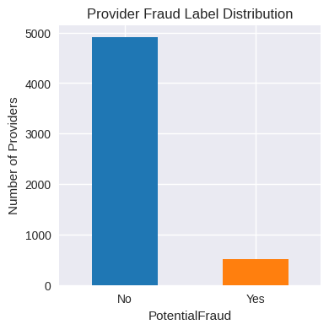

Slide 9
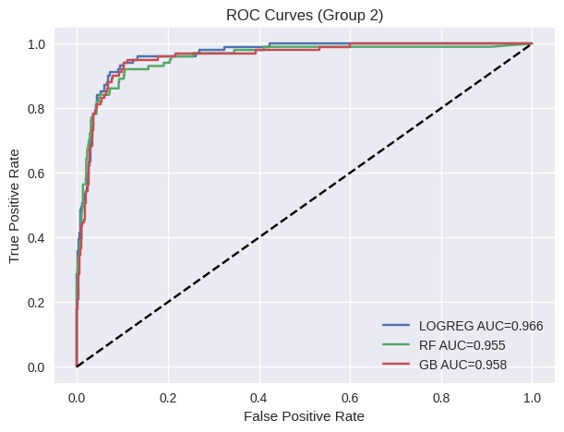

Slide 10
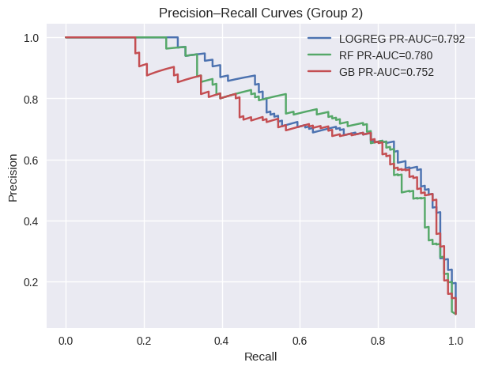

Slide 11
Results Summary
Model successfully detects fraud patterns
  Random Forest showed higher recall
  Balanced training improved performance

Slide 12
Conclusion
ML helps identify fraudulent providers
  SMOTE improved prediction of minority class
  Further tuning can improve accuracy

Slide 13
Future Work
Try advanced models like XGBoost
  Hyperparameter tuning
  Feature engineering improvements

